Slide 1



CANE SHOOTING GAME
REVIEW-2
BY:
NISHA P (23CDR112)
PRANEETHA R S (23CDR123)
15.03.2025

Slide 2
Project Description
There is a lack of:
Simple 2D games suitable for beginners
Engaging gameplay that keeps users interested
Customizable projects that help students experiment and learn
Cane Shooting addresses this gap by:
Offering an arcade-style 2D shooting game
Using Python and Pygame for easy and fun game development
Including SQLite to store and display high scores

Slide 3
GOAL
To develop a simple, fun, and educational 2D shooting game using Python and Pygame that helps learners understand the basics of game development and database integration.
OBJECTIVE
Develop a playable 2D arcade shooting game using Python and Pygame.
Enable player interaction through keyboard controls for movement and shooting.
Implement collision detection to reward players for hitting targets.
Create a scoring system that tracks and displays points in real-time.
Use SQLite to store high scores, so they persist between game sessions.
3

Slide 4
Types of Module
Player control module
Enemy module
Weapon system module
Collision detection module
Scoring module
Game over and restart module

Slide 5
Technologies Used
Python – A beginner-friendly programming language used to build the game logic.
Pygame – A library in Python for creating 2D games with graphics, sound, and user input.
SQLite – A lightweight database used to store and retrieve high scores locally.
Software Used
Visual studio code.
5

Slide 6
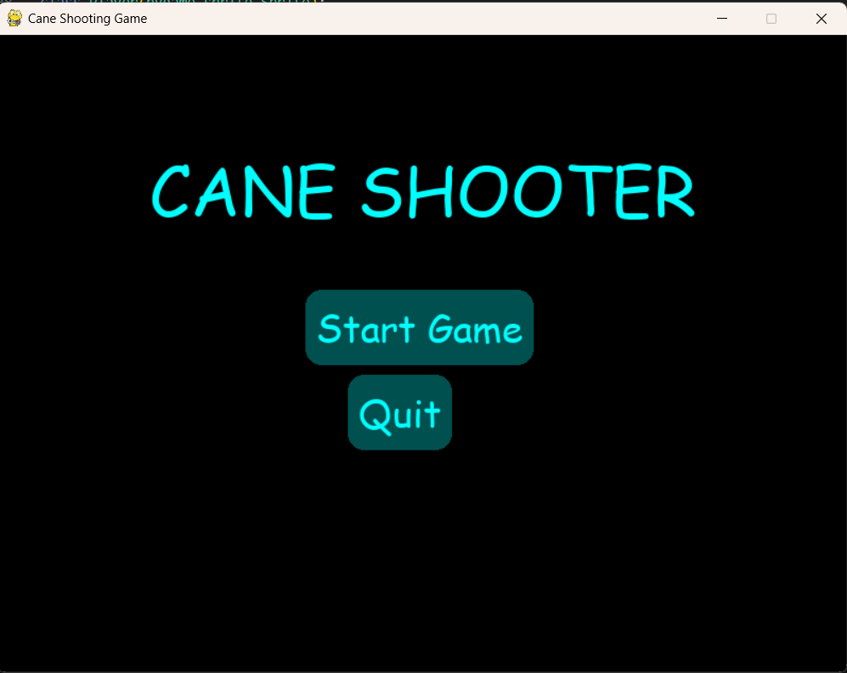
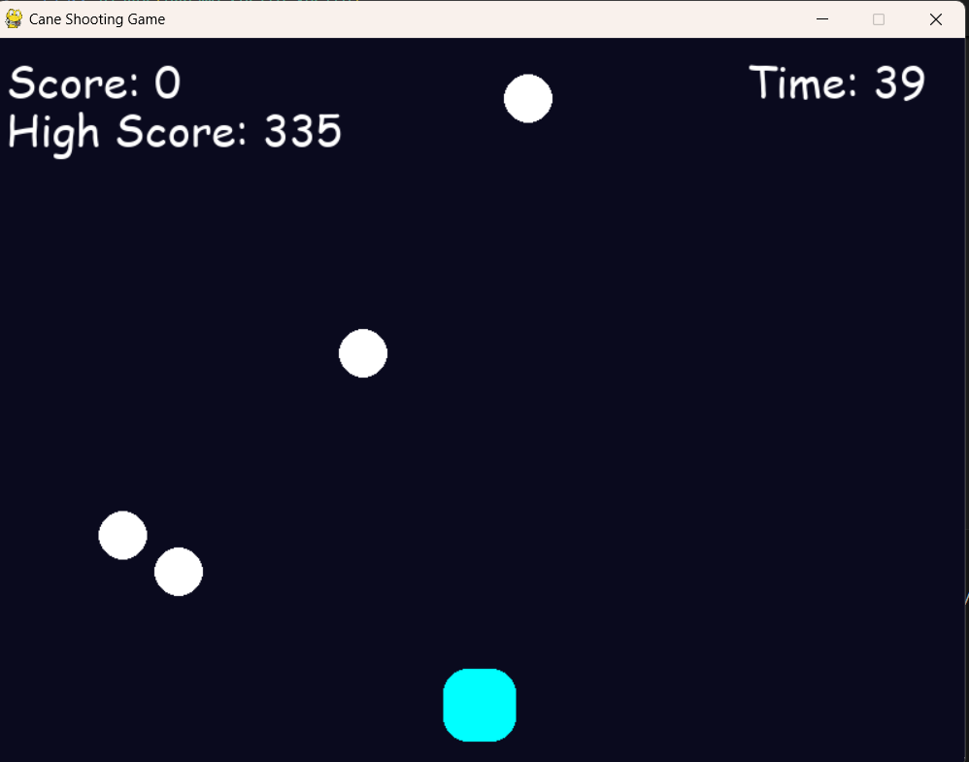
IMPLEMENTATION

Slide 7
Thank you!!

